Slide 1


Data Structures
(OOP Revision)
Ahmed Makki

Slide 2
OOP Concepts
OOP concepts in Java are the main principles behind Java’s Object Oriented Programming (OOP), to support goals of modern software applications such as Portability, Reusability and Adaptability.
The four main principles of object-oriented programming are:
abstraction, encapsulation, inheritance and polymorphism.
Class and Objects – These are at the core of OOP.
A Class is the blueprint or template for its objects.
Objects are instances of a class.
Each object has its own state, Behavior, and identity.

Slide 3
Encapsulation
In object-oriented programming, you do not allow your data to flow freely inside the system.
Instead, you wrap the data and functions into a single unit (i.e., in a class). The purpose of encapsulation is to:
Put restrictions in place so that the components of an object cannot be accessed directly. In some OOP languages, the hiding of the information is not implemented by default. So, they come up with an additional term called information hiding.
In Java, you can implement encapsulation in various ways. For example, you can use the access specifiers (or modifiers) and getter-setter methods in this context.
The public class modifier designates that all classes may access the defined aspect. For example,
public class Counter {…}
The designation of public access for a particular method of a class allows any other class to make a call to that method
Other modifiers include static, abstract, final etc

Slide 4
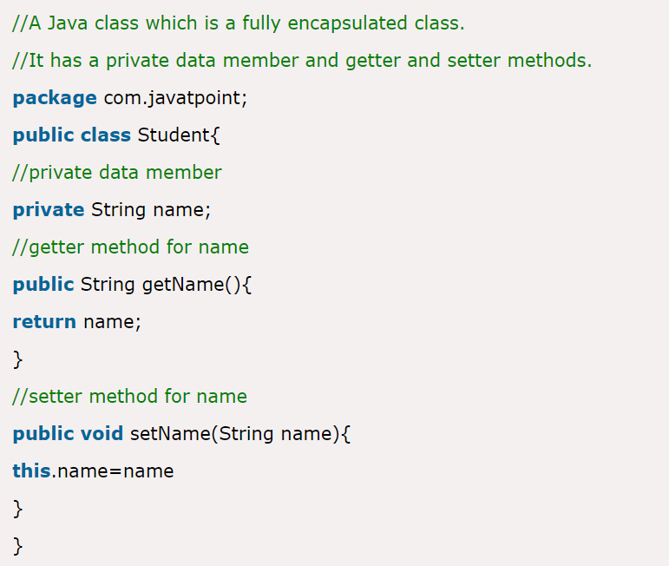
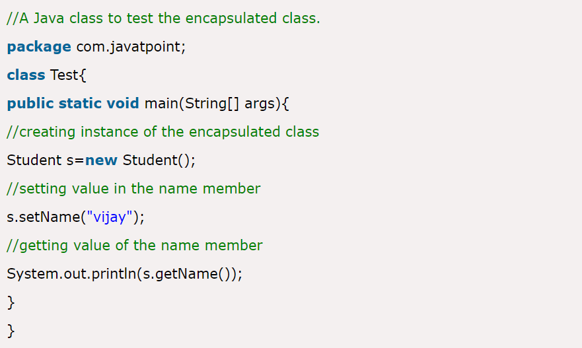
Encapsulation
File: Student.java
Example of Encapsulation in Java
In this example:
The variable “name” is kept private or “encapsulated.”
getter-setter method
File: Test.java

Slide 5
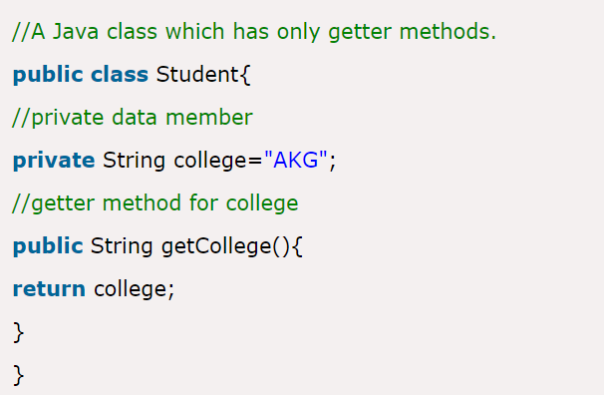

Encapsulation
Read-Only class
Now, you can't change the value of the college data member which is "AKG".

Slide 6
Abstraction
The key purpose of abstraction is to show only the essential features and to hide the background details of implementation. It simply uses simple things to represent more complex things for reusability.
Abstraction is also very much related to encapsulation, but the difference may be easily understood with a simple day-to-day scenario.
For example:
A programmer can create several different types of objects. These can be variables, functions, or data structures. Programmers can also create different classes of objects.
For instance, a class of variable might be an address. The class might specify that each address object shall have a name, street, city, and zip code. The objects, in this case, might be employee addresses, customer addresses, or supplier addresses.
https://stackify.com/oops-concepts-in-java/

Slide 7
Inheritance
Whenever we talk about reusability, we’ll generally refer to inheritance, which is a process in which one object acquires the properties of another object.
Consider this example.
Bus is one type of Vehicle because it fulfils the basic criteria of a Vehicle that is used for transportation purposes.
Similarly, Train is another type of Vehicle.
And even though a Goods Train and a Passenger Train are different, we can say that both inherit from the Train category (or class) because ultimately both of them fulfil the basic criteria of a Train, which in turn is a Vehicle. So, you can simply say that hierarchical classifications are supported with the concept of inheritance.
The key advantage is that you can avoid lots of duplicate code with this mechanism.

Slide 8
Inheritance
Example of Inheritance in Java
It’s quite simple to achieve inheritance as an OOP concept in Java. Inheritance can be as easy as using the extends keyword to define a new class (child class or subclass) that inherits properties from an old class (parent class).
class Vehicle {
}
class Train extends Vehicle {
}

Slide 9
Polymorphism
Polymorphism is generally associated with one name with many forms. It essentially involves the use of the same word (method) to mean different things in different contexts.
Consider the Behavior of your pet dog. When it sees an unknown person, it is angry and starts barking a lot. But when it sees you, it makes different noises and behaves differently… Same name, different action.
Two forms of polymorphism in JAVA include:
Overloading Method: A single method name might function in different ways depending on what arguments are passed to it or depending on which contexts in which its called.
Overriding Method: The child class can use polymorphism to override a method of its parent class. Therefore a method can be used in different ways depending on whether it’s invoked by an object of the parent class or an object of the child class.

Slide 10
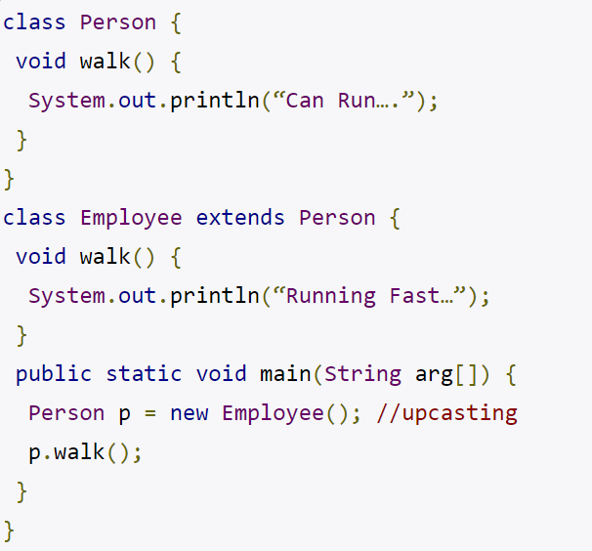
Polymorphism
Example of Polymorphism in Java
In this example:
We have two classes: Person and Employee.
The Employee class inherits from the Person class by using the keyword extends. Here, the child class overrides the parent class. For the full example

Slide 11
Some good practices of OOP concepts in Java
The aim of OOP concepts in Java is to save time without sacrificing security and ease of use. These practices are all oriented towards advancing that main goal.
Avoid Repetition: Make sure to never have two blocks of identical code in two different places. Instead, have one method you use for different applications.
Security: If you expect your Java code to change in the future, encapsulate it by making all variables and methods private at the outset. As the code changes, increase access to “protected” as needed, but not too public.
Single Responsibility: A class should always have only one functionality. That way, it can be called and/or extended on its own when new uses arise for it, without causing coupling between different functionalities.
Open Closed Design: Make all methods and classes Closed for modification but Open for an extension. That way, tried and tested code can remain static but can be modified to perform new tasks as needed.

Slide 12
Classes and Objects
In simple language, you can say that in structured programming, you segregate the problem into small functions, and in OOP, you divide the problem into objects.
You are familiar with data types like int, double, float etc.
You know that these are built-in data types or primitive data types because they are already defined in a computer language.
But when you create your own data type, let’s say, Student, you need to create a Student class.
Just as when you need to create an integer variable, you mention the int first, similarly, when you need to create a Student object (e.g., john), you need to mention your Student class first. So, when you’re familiar with OOP, you may say something like this: a dog is an object from a Mammal class, your car is an object from a Vehicle class, and so on.

Slide 13
Any Questions?

Slide 14
Data types (primitive and references)
Operators
Flow Control
Classes and Objects
Arrays
Readability and Style

Slide 15
Primitive Datatypes
Keyword | Description | Size/Format
(Integers)
byte | Byte-length integer | 8-bit two's complement
Short | Short integer | 16-bit two's complement
Int | Integer | 32-bit two's complement
long | Long Integer | 64-bit two's complement
(real numbers)
float | Single-precision floating point | 32-bit IEEE 754
double | Double-precision floating point | 64-bit IEEE 754
(Other Types)
char | A Single character | 16-bit Unicode character
Boolean | A Boolean value (true or false) | true or false

Slide 16
Operators
Assignment: = += -= *=
Numeric: + - * / % ++ --
Relational: == != < > <= >=
Boolean: && || !

Slide 17
Operators
Assignment Statement
Assignment operator is
E.g. i = 7;
Variable must be on the left
1 = i not correct.
k = 1 correct.
k = i correct.
Expressions
x = 3 + y;

Slide 18
Flow Control
Selection (Decision) Statements
if / if else
switch
Iteration (Looping) Statements
for
while
do while
break Statement
Continue Statement

Slide 19
Flow Control - if else Statement
Format
if( Boolean_Statement )
statements if true
else
statements if false
Example
if( value >= 0 )
goCompute(value);
else {
System.out.println("Negative!");
}

Slide 20
Flow Control – switch Statement
Similar to sequence of nested if statements
switch(expression){
case 0:
statements…
break;
case 1:
statements…
break;
default:
statements…
}
NOTE: the case statements “fall through”. A break statement prevents this from happening.
Expression must evaluate to char, byte, short, or int.
If you leave out break, the switch will evaluate all cases.

Slide 21
Flow Control – switch Statement
Switch statement is useful when testing for particular characters
Example
char c = input a character, or equivalent;
switch(c){
case 'a':
System.out.println("The character was a");
break;
case 'c':
System.out.println("The character was c");
break;
default:
System.out.println("Not a nor c.");
}

Slide 22
Flow Control – while loop
Format
while( continue_condition ){
statements…
}
Note that condition is only evaluated at the top
The loop is executed as long as the condition is satisfied
Example
i=1;
while( i<10 ){
System.out.println(i);
i=i+1;
}
What would be the output?

Slide 23
Flow Control – do while loop
Format
do {
statements…
}
while ( continue_condition );
Note the semicolon!
When would you use the loop

Slide 24
Flow Control – for loop
Format
for(initial condition increment){
statements…
}
Example
int i;
for(i = 0; i < 100; i=i+1){
System.out.println("Loop");
}
Must evaluate to a boolean

Slide 25
Flow Control – break & continue Statements
Break breaks the loop (aborts execution)
for(int i= 0; i< 10; i++){
if(i== 5)
break;
System.out.println(i);
}
Continue interrupts the execution of the current iteration within the loop but maintains the loop execution
for(int i= 0; i< 10; i++){
if(i== 5)
continue;
System.out.println(i);
}
Which numbers are printed?

Slide 26
THE END

